Slide 1
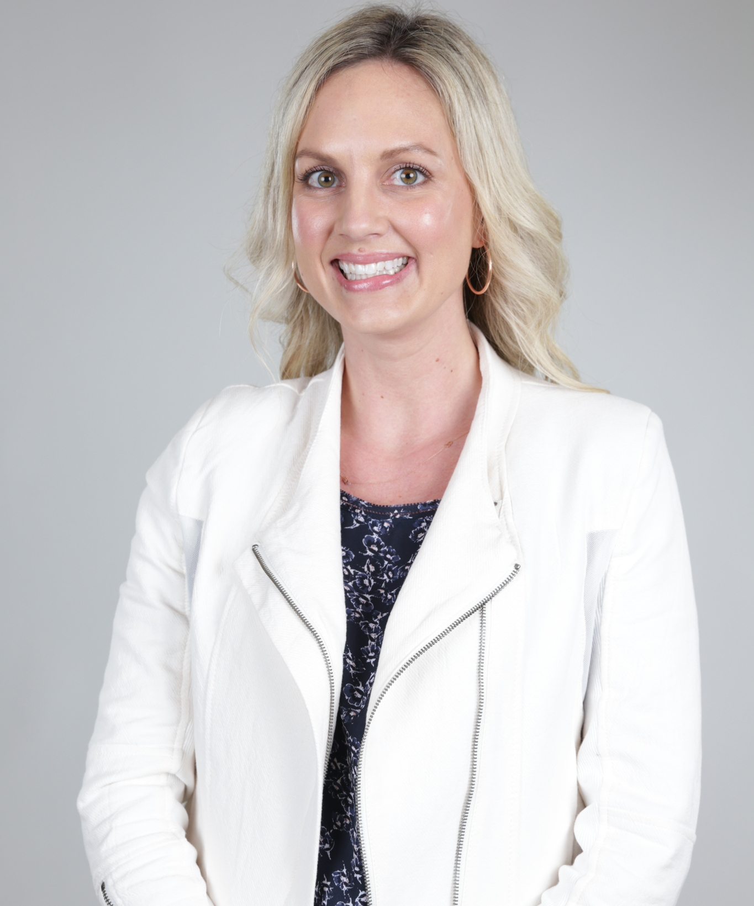
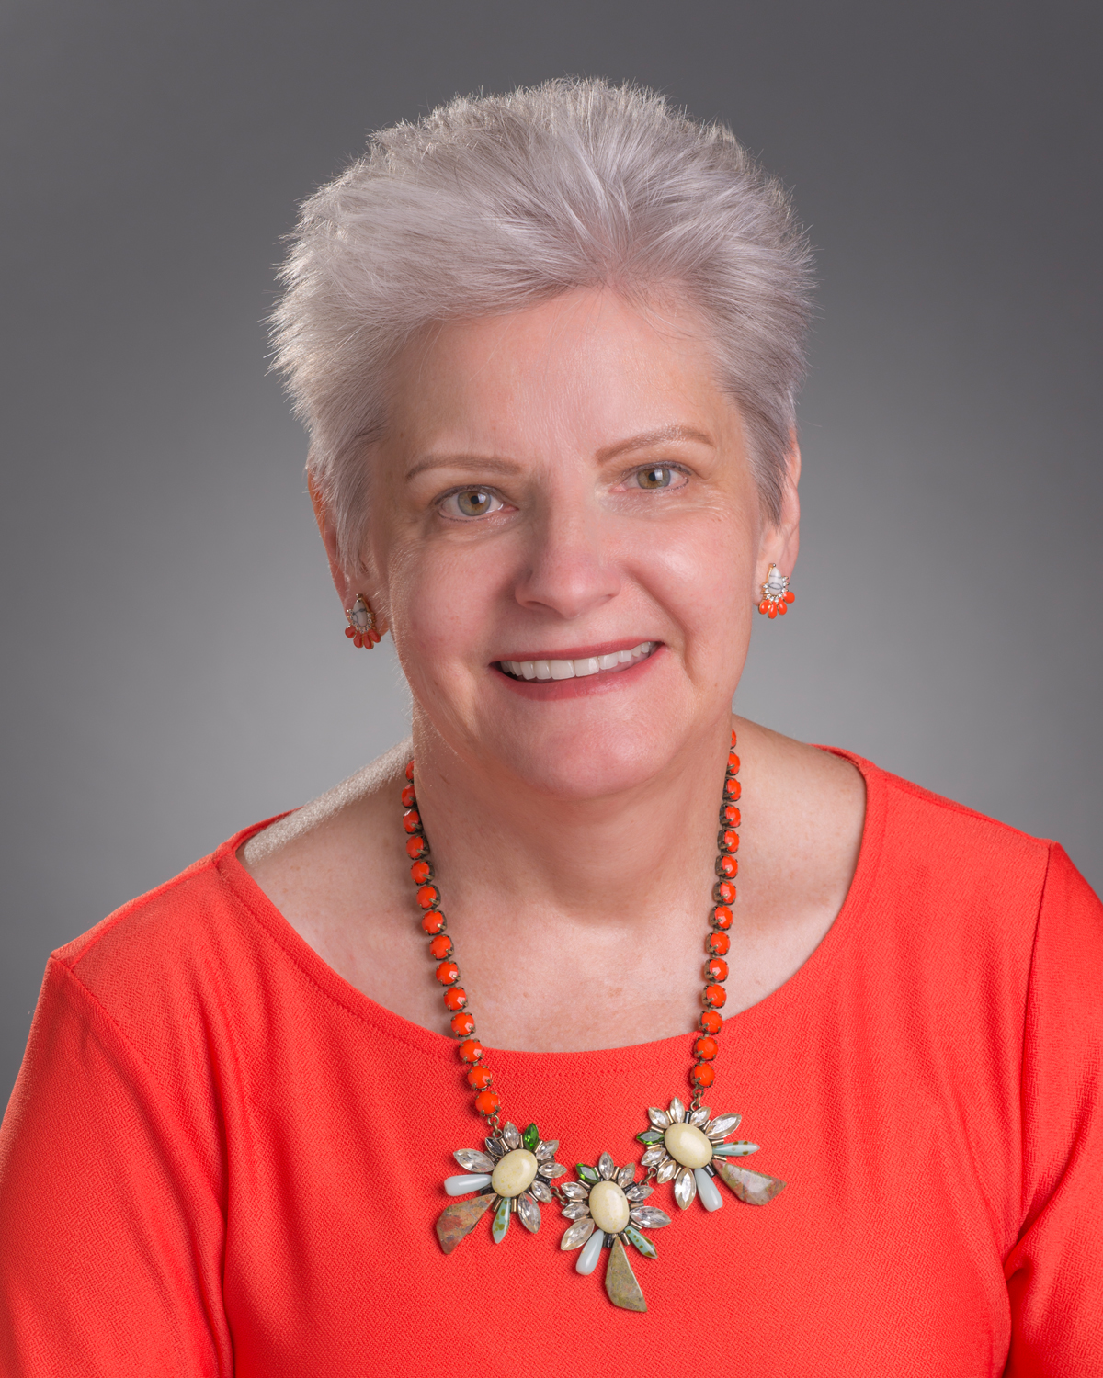
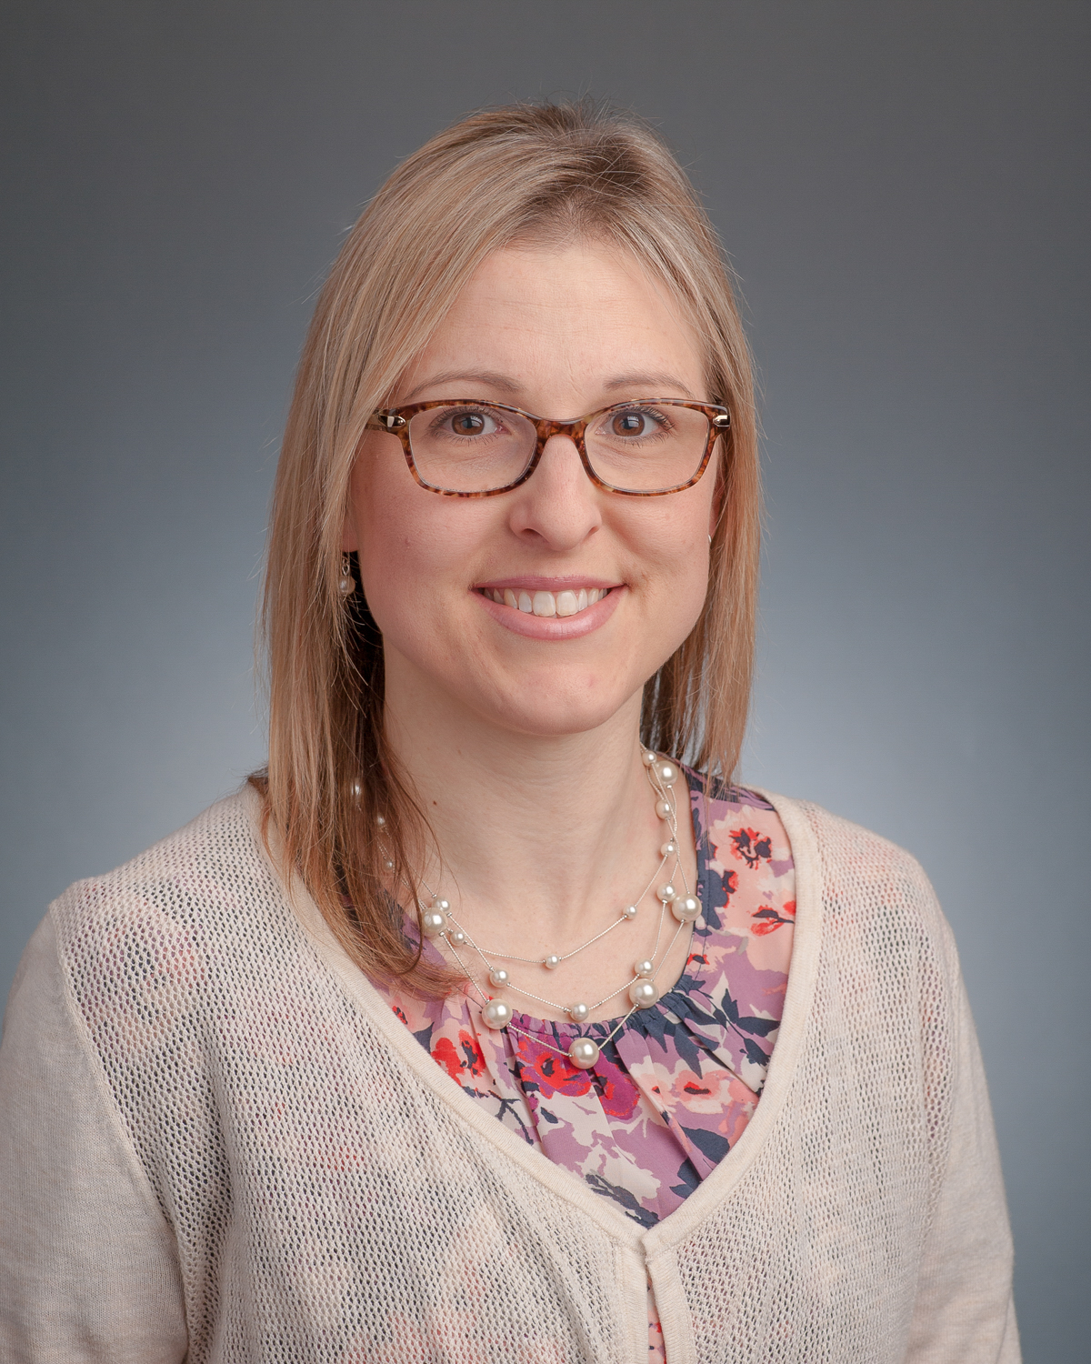
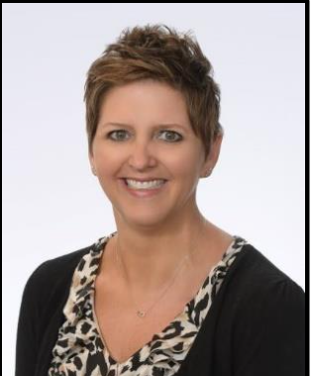
Janssen Representatives
Ashley Korn- asouthw1@its.jnj.com
Barbara Rodgers, RN- Brodger3@its.jnj.com
Kara Raso- Kraso@its.jnj.com
Karen Schiavo, ARNP, NP-C- Kschiavo@its.jnj.com

